Slide 1

LSTM Next Word Predictor.
On 129 Deep learning Q&A.
Adepu Bharath Kumar

Slide 2
Technologies used
Html
CSS
bootstrap
Python
Flask
Deep learning (tensorflow, LSTM)
Pickle
numpy

Slide 3
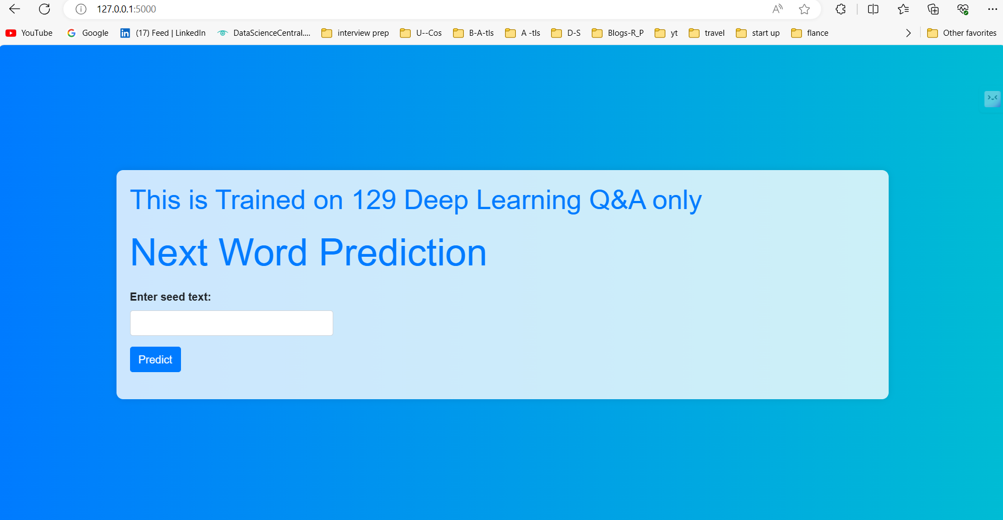
Front End

Slide 4
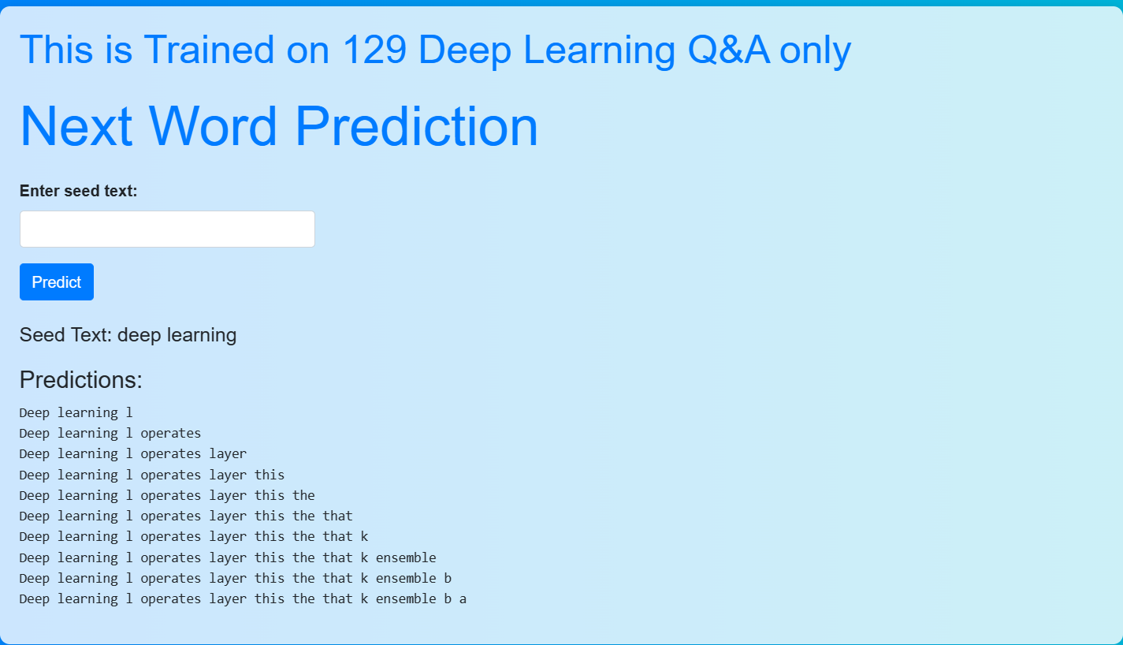
Output

Slide 5
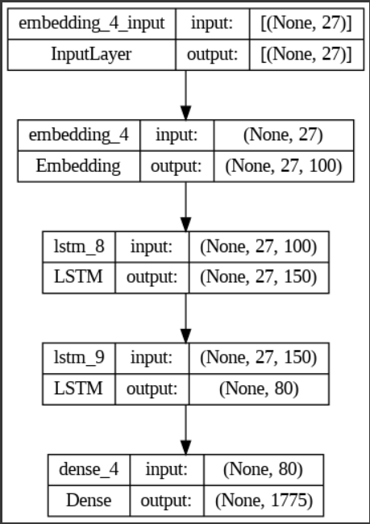
Model architecture

Slide 6
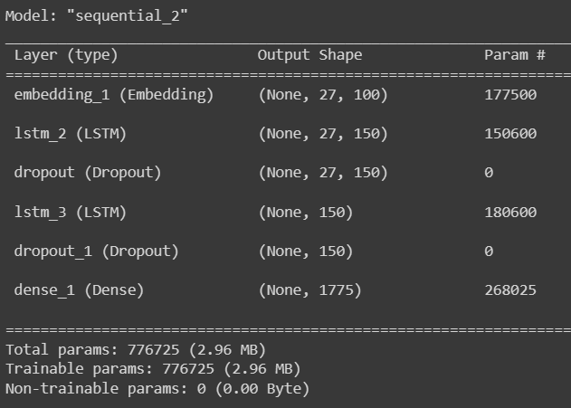
Model Summary

Slide 7
Thank you

